Slide 1
Learning Object-Centric Transformation for Video Prediction
Xiongtao Chen, Wenmin Wang*, Jinzhuo Wang, Weimian Li
Notes:
Hi, I am Xiongtao Chen from Peking University, China. It’s my pleasure to be here to give this presentation. Today I will talk about “Learning Object-Centric Transformation for Video Prediction”. (This is a joint work with Wenmin Wang, Jinzhuo Wang and Weimian Li.)

Slide 2
Outlines
Introduction
Main idea
Network structure
Adversarial training
Experimental results
Conclusions & future work
Notes:
My talk will be divided into the following sections: introduction of video prediction, our main idea and approach, our network structure, adversarial training, experimental results and analysis, conclusions and future work.

Slide 3
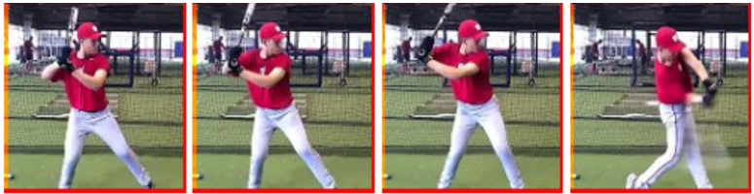
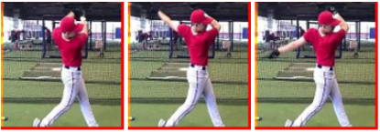
Introduction
Task: future frame prediction
Challenges:
plausible motion and appearance
sharp prediction
uncertain future
long-term prediction
…
Notes:
Recently, predictive learning has gained more and more attention in computer vision. In this work, we address the problem of future frame prediction in video sequences. For example, given the first four frames, human can imagine how the baseball player would swing in the near future. how can computer predict what next frame would be like as human do? Due to the complexity and ambiguity inherent in video data, there are many challenges in this task, including: produce plausible motion and appearance, sharp prediction, , uncertain future and long-term prediction.

Slide 4


Introduction
Existing methods
Regression Model
Transformation Model
Parameters fixed after training
Global motion transformation are not suitable for all objects
Notes:
Traditional methods utilize optical flow to predict the next frame, which requires accurate capture of the optical flow. (click) Recently, regression model is adopted to reconstruct the target frame directly in many work, including kinds of encoder-decoder models or LSTM-based models. However, network parameters of regression model are fixed after training. To process multiple kinds of objects and motion patterns, transform model is used to produce transformation kernels dynamically conditioned on particular inputs. The kernels are then applied to the input image to generate the next frame. But global motion transformation produced from the whole image are not suitable for all objects in the same scene.

Slide 5
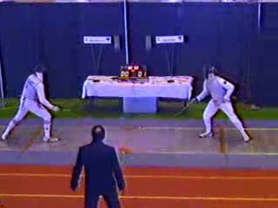
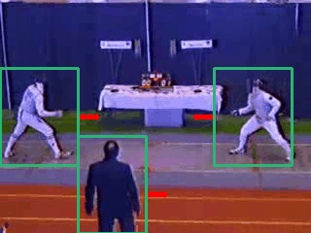
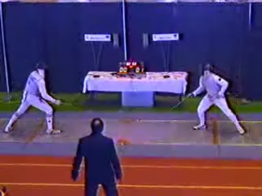
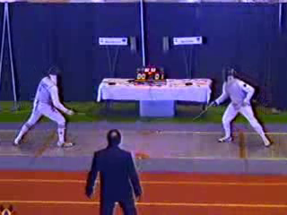
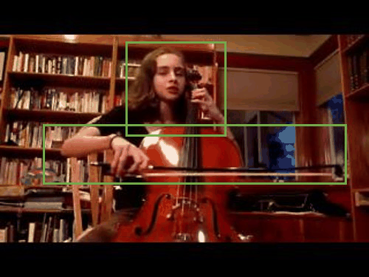
Main idea
Our Motivation
Different objects in the same scene often move and deform in different ways.
kernel
Movement
Next frame
0 | 0 | 0
1 | 0 | 0
0 | 0 | 0
0 | 0 | 0
0 | 0 | 1
0 | 0 | 0
Visual attention. In human visual system, one often pays attention to the key objects that contain crucial motion signals, rather than observe the whole visual space in a dynamic scene at once.
Notes:
As we know, different objects in the same scene often move and deform in different ways intuitively. Take this fencing competition for example, the player on the left and the referee move right together while the player on the right side move left. If we use this global convolutional kernel to transform the original image, all three person will move left together. And if this kernel is used, all persons will move right. This indicates that global transformation may be not reasonable to all objects in the same scene.
Besides, in visual cognition literature, humans do not tend to observe the whole visual space in a dynamic scene at once. Instead they only concern about what objects exist and what happens to them respectively. Consider this video sequence of playing cello, motions mainly occur at the marked green boxes, which should be paid more attention for next frame prediction.

Slide 6
Main idea
Motivation
Transform models can deal with multiple motion patterns by generating motion transformation dynamically conditioned on particular inputs.
Different objects should be endowed with different motions.
Pay more attention to key object regions.
Our approach
Video Prediction → Iterative attention and refinement.
Pay attention to key objects as humans do.
Learn object-centric transformation.
Refine part by part.
Notes:
Our motivation can then be concluded as following:
Transform models can deal with multiple motion patterns by generating motion transformation dynamically conditioned on particular inputs.
Different objects should be endowed with different motions.
Pay more attention to key object regions which contain crucial motion signals.
We then propose our approach to address this problem. We formulate the process of next frame prediction as one of iteratively attention and refinement, that is:
Pay attention to key objects as humans do.
Learn object-centric transformation to transform each key object regions;
Use these transformed images to refine the original image part by part.

Slide 7

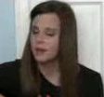
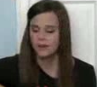


Main idea
Pay attention to key objects
Learn object-centric transformation
Refine part by part
Transformation Network
Input frame
Recurrent connected
Attention Module
Next frame
Notes:
We use this example to explain our ideas more specifically. Here are the last input frame and the next frame we want to predict. We can see that the girl turns her head and moves her hand down when playing guitar. (click) Firstly, we design an alternative attention module to select the key object patches, including the head region and the hand region that we concern about.
Next, for each key object patch, we design a transformation network to learn motion transformation and convert this patch to a transformed image patch.
Since there may exist underlying correlation between different object patches, we add recurrent connections between the transformation networks and form a recurrent neural network (RNN). Finally, we use the transformed images to refine the original input frame part by part to produce next frame.

Slide 8

Network Structure
Transformation Network: kernel-generation
Transformation Network
kernels
transformed images
P_{t}
Notes:
Now we introduce our network structure in detail. First, let’s consider the transformation network. This is the core of our learning agent. Take a small sequence of video patches as input, to generate motion transformation kernels, the network consists of several convolutional layers and fully-connected layers, the output is then reshaped as convolution or affine kernels. We then apply these kernels into the last input patch to produce several transformed images.

Slide 9
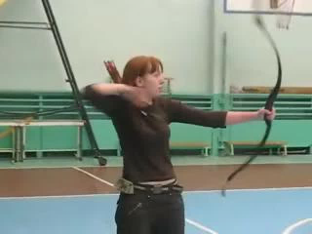
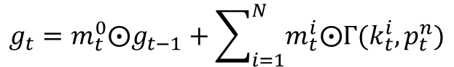
Network Structure
Transformation Network: mask-generation
padding
transformed images
Transformation Network
masks
kernels
P_{t}
masking
$$g_{t}=m_{t}^{0}⨀g_{t−1}+\sum_{i=1}^{N}{m_{t}^{i}⨀Γ(k_{t}^{i},p_{t}^{n})}$$
Notes:
But how can we combine these transformed images and the input frame into one output frame?
The simplest but a little awkward way is to average all these images.
Instead, we use a decoder network to produce several weight matrices, called masks. These masks donate the weights for each image at each pixel position.
Then the transformed images and input frame can be combined into one image by multiplying the masks.

Slide 10

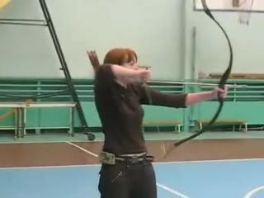
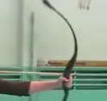
Network Structure
Recurrent connected
padding
transformed images
Transformation Network
kernels
h₀
masks
P₁
masking
…
…
…
Attention Module
h₁
h_{t-1}
masks
P_{t}
masking
h_{t}
Notes:
With the transformation network constructed, we can transform each key object patch and refine the input image part by part to obtain the final prediction. Here is the main framework of our model, which is formulated as a deep recurrent network.

Slide 11
Network Structure
Attention Module: Pyramid-like Sampling
Split input frames into bins at multiple levels.
Compute motion amplitude (l₂ difference) for each bin as score f_{i}.
T bins with top scores are selected as key object regions.
Level 1
Level 2
Level 3
Notes:
The next question, then, is how to design the attention module.
No doubt, It is challenging to focuse on key objects automatically in an unsupervised fashion is no doubt.
We apply two strategies in our work.
The first one is pyramid-like sampling. We split input frames into bins at multiple levels.
Then we compute motion amplitude for each bin as score.
We select those bins with top scores as key object regions, which crucial motion signals.
We use l2 difference to represent the motion amplitude.
The left figure shows the l2 differences for each bin at level 1.
The advantage of this method is that a small patch may be selected again in the larger patch and help the model to learn better motion transformation.

Slide 12
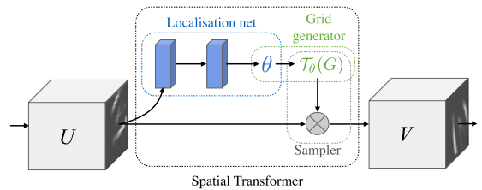
Network Structure
Attention Module: Spatially-transformed attention
Spatial Transformer
Automatically learn to focus on multiple key object patches
[Max Jaderberg et al., 2015]
Notes:
The second method we use in our work is spatially-transformed attention.
As show in the left figure, for each RNN timestep, we use a shared localisation network to produce a set of parameters theta.
Theta is used to sample a patch from the input image. Different from the pyramid-like sampling, this multi-stream transformer learns to focus on key object patches automatically during training.
This network is based on the great work Spatial Transform Network proposed in 2015, as shown in the right figure.

Slide 13
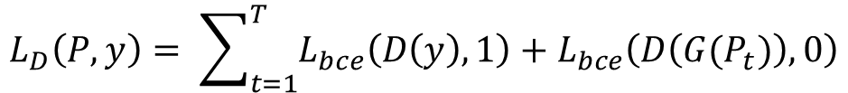
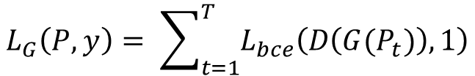
Adversarial Training
Adversarial training can help to deal with blurry predictions caused by l₂ loss.
Discriminator loss:
Generator loss:
$$L_{D}\left(P, y\right)= \sum_{t=1}^{T}{L_{bce}\left(D\left(y\right), 1\right)+L_{bce}\left(D\left(G(P_{t})\right), 0\right)}$$
$$L_{G}\left(P, y\right)= \sum_{t=1}^{T}{L_{bce}\left(D\left(G(P_{t})\right), 1\right)}$$
Notes:
(L2 loss is often used to train the model for image reconstruction. ) In the recent several years, Generative adversarial networks have attracted huge attention. And Adversarial training can help to deal with blurry prediction caused by l2 loss. We also adopt this training manner to train our model. The Discriminator loss and Generator loss are defined as following. The discriminator tries to distinguish the real and the fake while the generator tries to confused the discriminator.

Slide 14
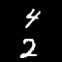

Experimental Results
Moving MNIST Dataset
Sequences that describes two MNIST digits moving with constant velocity and bouncing off walls.
UCF101 Dataset
Contains 13320 realistic videos belonging to 101 action categories.
The same train-test-split as in [Mathieu et al., 2016]
Evaluation criteria
Peak Signal to Noise Ratio (PSNR)
Structural Similarity Index Measure (SSIM)
Notes:
We evaluate our model on the Moving MNIST and UCF101 datasets. The Moving MNIST dataset is made up of sequences that describes two MNIST digits moving with constant velocity and bouncing of walls, as shown in these two gifs. And the UCF101 contains 13320 realistic videos belonging to 101 action categories and we use the same train-test-split with the previous work of Mathieu.
There is no unified metric to quantify the generated frames for video prediction task, we mainly use PSNR and SSIM metrics to assess the predicted frames in our experiments.

Slide 15
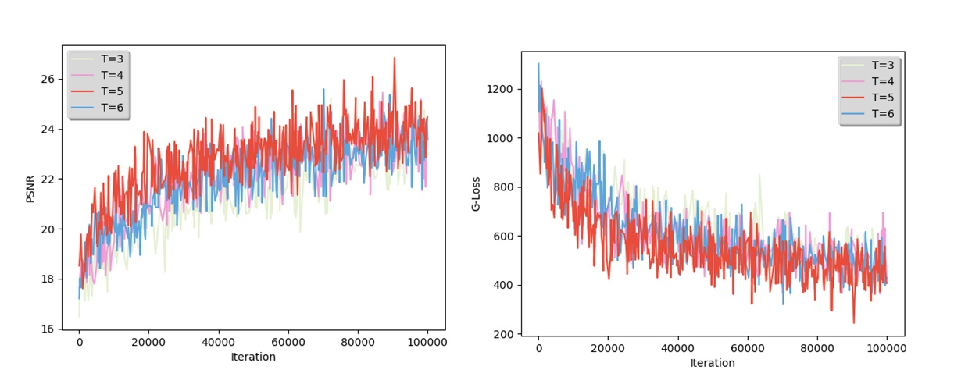
Experimental Results
Moving MNIST Dataset
Table 1: Comparison of PSNR and SSIM results for 5 variants of our architecture on Moving MNIST dataset.
5 architecture variants
GL
PL-Parallel-Fixed
PL-RNN-Fixed
PL-RNN-Pyramid
PL-RNN-ST
Model | PSNR | SSIM
GL | 21.0908 | 0.8821
PL-Parallel-Fixed | 21.4438 | 0.8982
PL-RNN-Fixed | 21.6490 | 0.9068
PL-RNN-Pyramid | 22.4324 | 0.9195
PL-RNN-ST | 23.0063 | 0.9344
Impact of number T of RNN steps
Comparison when T = 3, 4, 5, 6
Notes:
We first conduct experiments to examine 5 typical architectural variants and study the impact of different designs. These designs includes: global-level motion transformation network that observes the entire frames; patch-level network that observes some fixed locations in parallel; patch-level network that observes fixed locations recurrently; patch-level network that attends to key object regions recurrently with pyramid-sampling strategy or spatial transformer. From the table 1, we can see that models with attention strategies can achieve better PSNR and SSIM results.
In addition, we also explore the impact of RNN steps number when T equal to 3, 4, 5 and 6. the figure shows that model achieves better PSNR and lower generator loss when equals to 5.

Slide 16
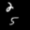
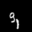
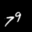
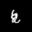

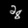
Experimental Results
Moving MNIST Dataset: examples of our predictions
PL-RNN-Pyramid
PL-RNN-ST
More examples
Ground Truth
Our Prediction
Notes:
We show some examples of our predictions compared with ground truth. The results show that the model can well capture the motion for each digits.
(click)
Here are more examples.

Slide 17
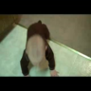
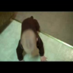
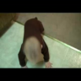
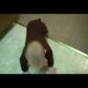
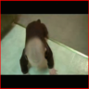
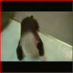
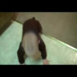



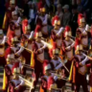
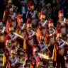


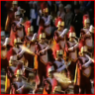
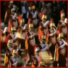

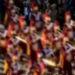


Experimental Results
Table 2: Comparison of PSNR and SSIM results on UCF101 dataset.
UCF101 Dataset
Compare with Multi-scale CNN [15, Mathieu et al., 2016]
Multi-scale CNN:
sharp prediction.
distortion for large motion and further frame prediction.
Ours: a little blurry but keep the shape of objects better.
Model | PSNR | SSIM
Last input | 28.6 | 0.89
Adv+GDL [15] | 31.5 | 0.91
Adv+GDL fine-tuned [15] | 32.0 | 0.92
PL-RNN-ST (ours) | 31.7968 | 0.9126
Generated examples
Input frames
Ground truth
Multi-scale CNN
Ours
Multi-scale CNN
Ours
Notes:
We choose the PL-RNN-ST as the optimal model to compare against two outstanding methods: the multi-scale CNN and transformation-based. The best model of Multi-scale CNN is pre-trained on Sports-1m dataset and fine-tuned on UCF101. However we only use UCF101 dataset to train our model. Table 2 shows that our model can achieve competitive results with multi-scale CNN.
We show two examples generated by our model and Multi-scale CNN.
For quality analysis, look at the first example, the multi-scale CNN can produce sharp prediction. But objects may warp for large motion and further frame prediction, which can be seen in the second example.
In contrast, our results is a little burry but keep the origin shape of objects better.

Slide 18









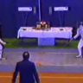
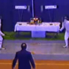
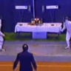
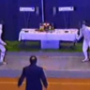
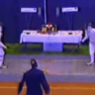
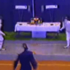
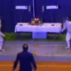
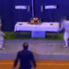
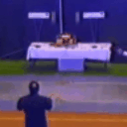

Experimental Results
Table 3: Comparison of PSNR and SSIM results on UCF101 subset from [25].
UCF101 Dataset
Compare with Transformation-based model [25, Joost et al., 2017]
Transformation-based model:
high classification accuracy.
unreasonable motion for different objects.
Ours: predict plausible motion.
Model | PSNR | SSIM
Multi-scale CNN [15] | 23.4726 | 0.8826
Transformation-based [25] | 25.8703 | 0.9193
PL-RNN-ST (ours) | 26.4688 | 0.9014
Generated examples
Input frames
Ground truth
Transformation-based
Ours
Transformation-based
Ours
Notes:
The tansformation-based model also learns patch-level transformation and can produce sharper frames and high classification accuracy. The psnr and ssim results comparison on a subset from their work is shown in Table 3. The transformation-based model achieve highest SSIM while our method can bring improvements for PSNR. Next we present the qualitative analysis. We can see that transformation-based model sometimes can’t not predict correct motion and the generated sequence seems not so natural. While our model can predict plausible motion.

Slide 19


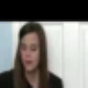

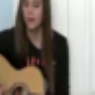
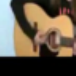



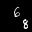

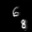
Experimental results
Analysis of Attention Module
Pyramid-like sampling
Input frames
Attention regions
Attention gif
Generation
Spatially-transformed attention
Attention regions
Attention gif
t=1
Input frames
Output frames
t=4
1k
2k
5k
10k
20k
Notes:
Now we make analysis of attention module. For pyramid-like sampling strategy, take this “playing guitar” sequence as example again, the module produce these 5 attention regions. Please recall the main idea section, we can notice that the second and fifth regions are exactly what we concern about.
For spatially-transformed attention, we show the attention windows at different RNN steps and iterations on Moving MNIST example. The figure indicates that the spatial transformer gradually focus on a fixed digit at a specific RNN step with the training iterations increasing.

Slide 20


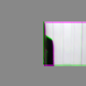




























Experimental results
Analysis of intermediate results
Transformed images
Attention Module
Notes:
What’s the transformed images like at each timestep? We visualize these intermediate results that applied to the input image step by step.

Slide 21
Conclusion & Future Work
Conclusion
Address the problem of video prediction via learning object-centric transformation.
Our model is structured around a deep recurrent neural network, which consists of a transformation network and replaceable attention module.
Our proposed method can produce plausible future frames.
Future work
Tackle the difficulty that multiple objects occlude each other with complex motion trajectory.
Long-term video frame prediction remains a great challenge.
Notes:
In summary, we proposed a novel model to address the problem of video prediction via learning object-centric transformation.
Our model is structured around a deep recurrent neural network, which mainly consists of a transformation network and alternative attention module.
Our proposed method can produce more plausible future frames.
There still remains some potential area to be improved.
First, for the situation that multiple objects occlude each other with complex motion trajectory, our model sometimes fails to distinguish the objects and describe their future movements and deformations well.
Second, long-term video frame prediction remains a great challenge in the field.

Slide 22
Thank you for your attention!

